Slide 1
WORD GUESSER
Multiplayer/Word Guesser Game
Milestone 1: Project Goal & Wireframes
Team: <Miguel A, Massimo P, Barry L & Zarina>
Stack: Render, Node.js, Express.js, PostgreSQL (+ React)

Slide 2
Overview
Web game where players guess a hidden word within a limited number of attempts or unlimited attempts, and difficult level
Immediate feedback per letter: correct spot, present elsewhere, or absent.
Modes: Daily, Practice (random), Multiplayer, different rounds if no one guess the word (change the word every round) & time challenge
Goals: Clean UX, fast gameplay, mobile‑friendly, sharable results.

Slide 3
Features
Auth: Sign Up / Log In & basic profile.
Game logic: n‑letter secret word, k attempts, letter feedback and on‑screen keyboard.
Single‑player: Daily + Practice.
Multiplayer: Lobby of rooms; create/join & scoreboard.
Results screen: stats + copyable.

Slide 4
Features
Required: Render (deploy), Node.js, Express.js, PostgreSQL.
Auth: JWT + bcrypt; UI: React, or ExpressJS), CSS.

Slide 5
Technologies
Client (React or Express.JS)
↕ fetch/JSON
Express API (auth, rooms, games, guesses, stats)
PostgreSQL (users, rooms, games, guesses, stats)

Slide 6
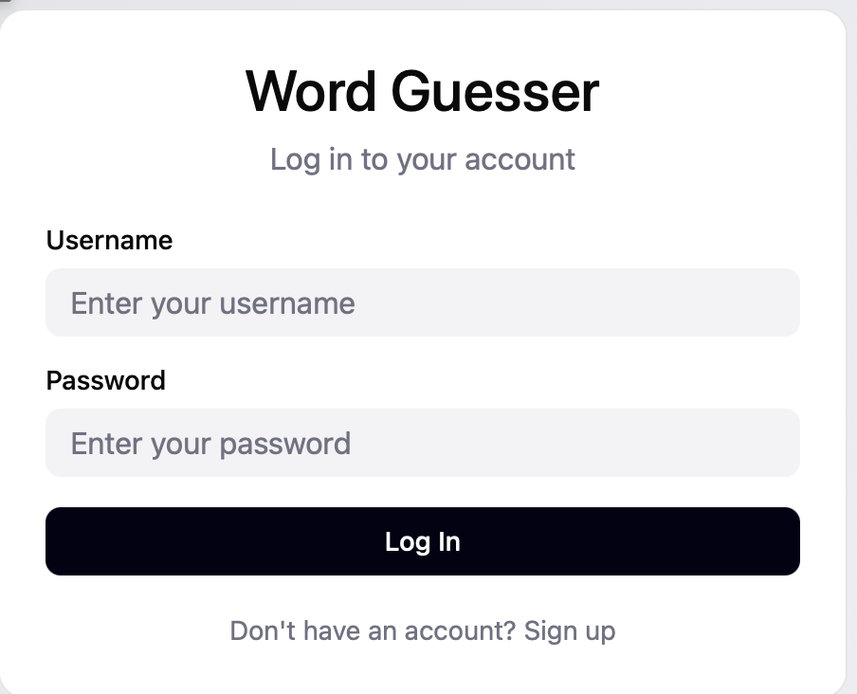
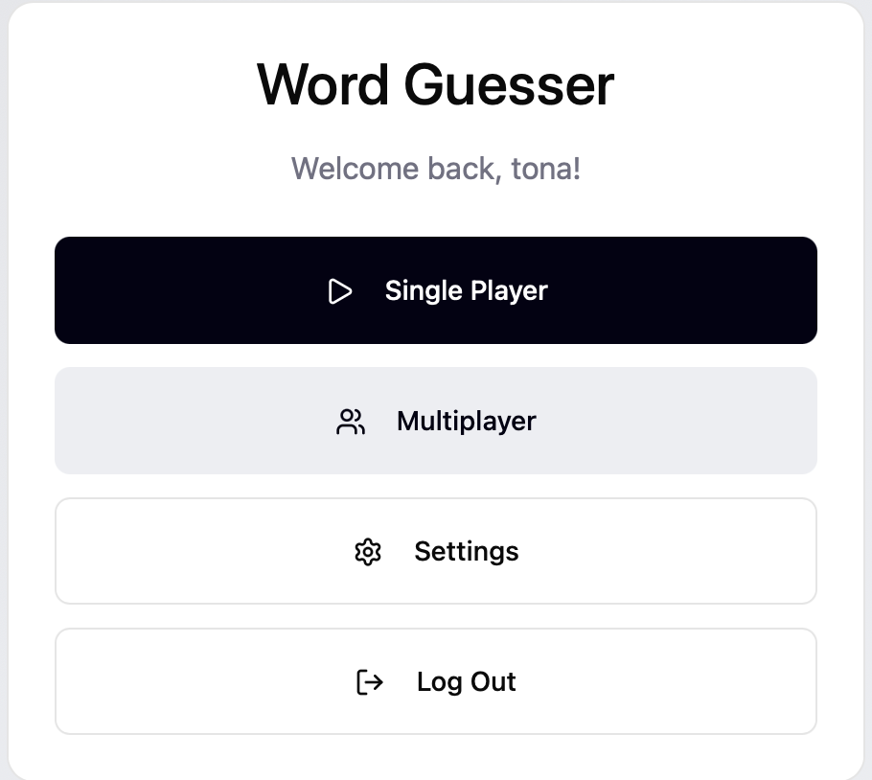
Wirefr

Slide 7
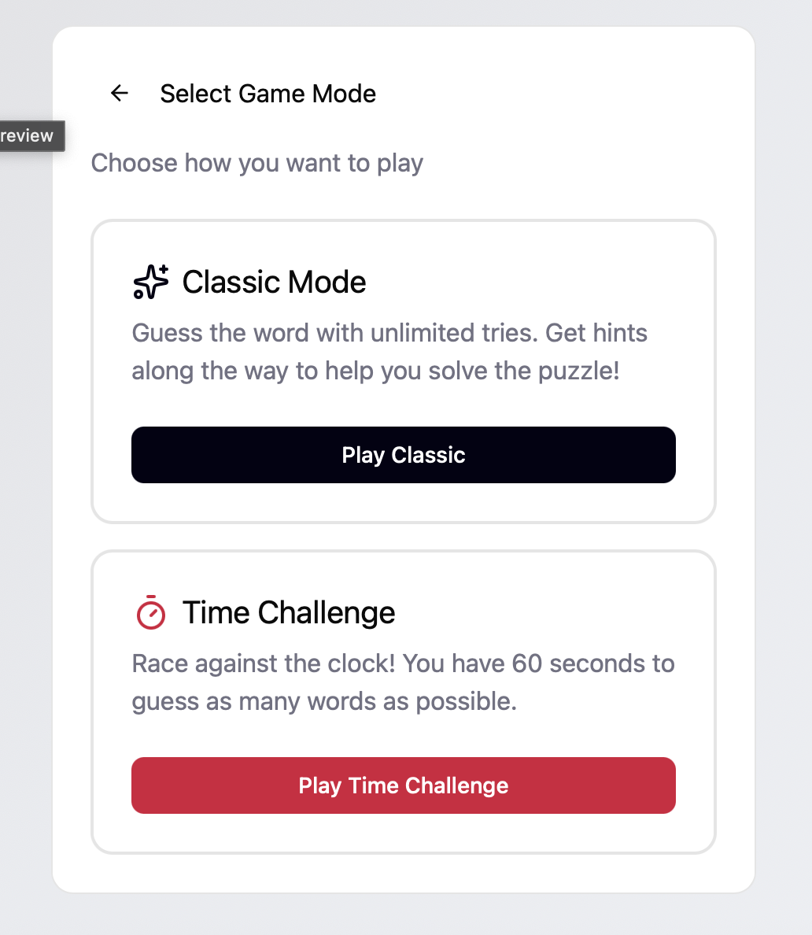
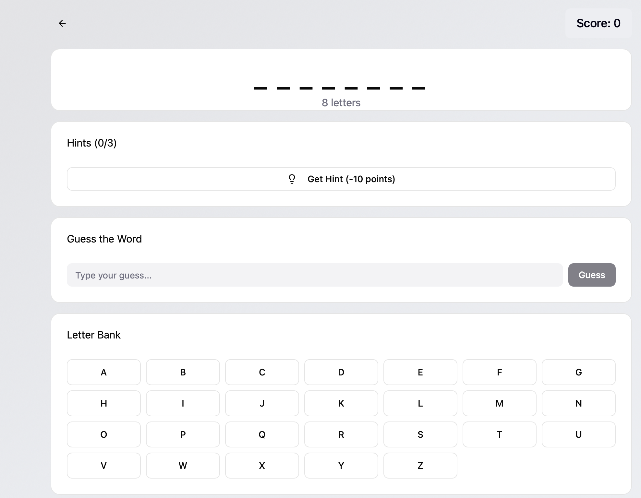

Slide 8
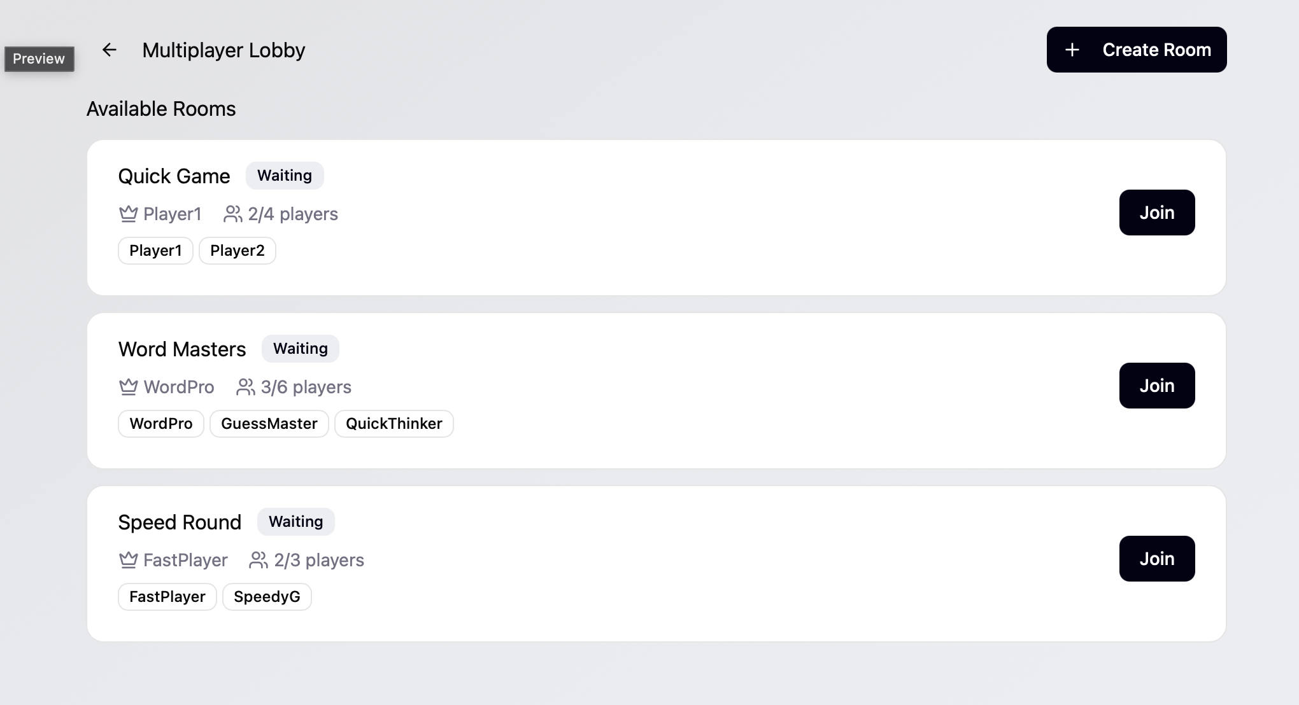
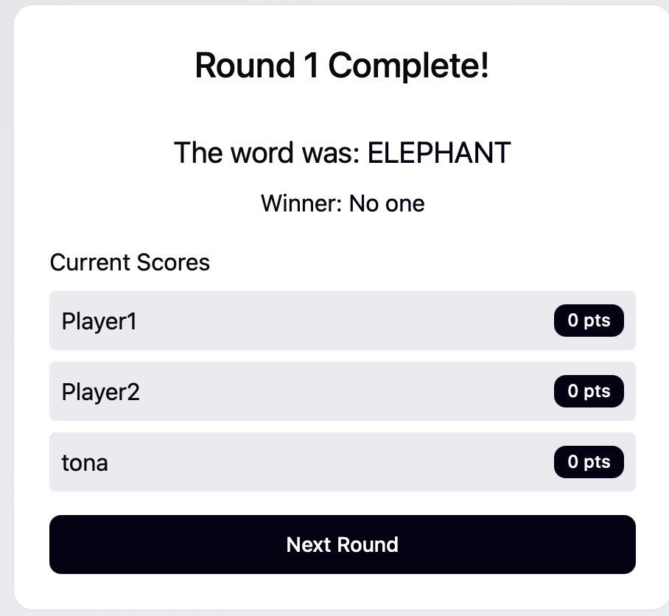
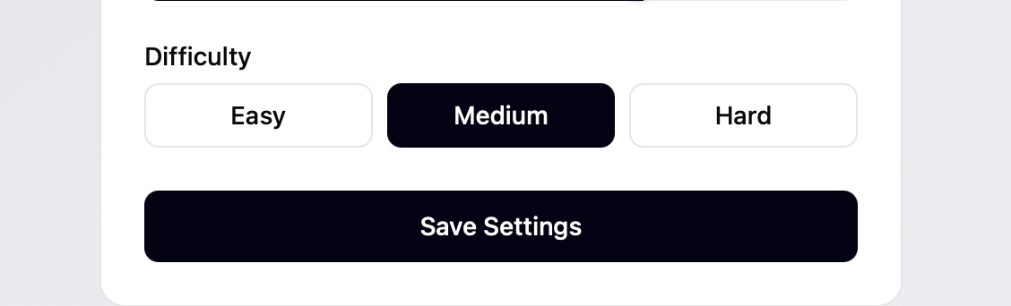

Slide 9
User Flows
Daily: Landing → Daily → guesses → results → share.
Practice: Landing → Practice → guesses → results.
Multiplayer: Lobby → Create/Join Room → Start → guesses → scoreboard → results.
Auth: Sign Up/Log In → Lobby; stats persist.

